Slide 1
CS 419: Production Rendering Intro to Color Aliasing and Sampling
Eric Shaffer

Slide 2
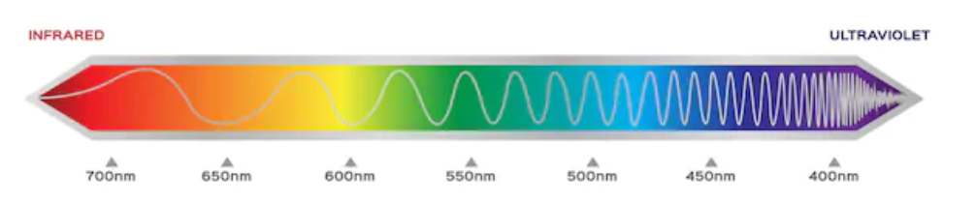
Quick Color Theory
We will discuss color in greater detail later in the semester
For now, we will quickly go over how we describe color of a pixel
Key points:
Conventional format: (r,g,b) indicating amount of light in 3 wavelengths
Sometime (r,g,b,a) where a is indicates transparency
Values in [0.0, 1.0]
It gets more complicated…..
Lots of other color spaces….
HDR uses a special storage format…still 3 channel though…
Light is not color…perception is complicated

Slide 3
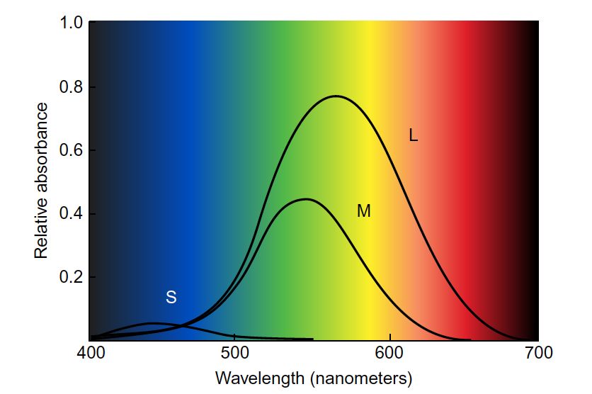
Quick Color Theory: Cone Response

Slide 4
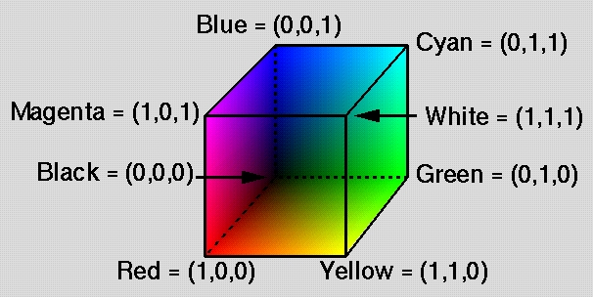
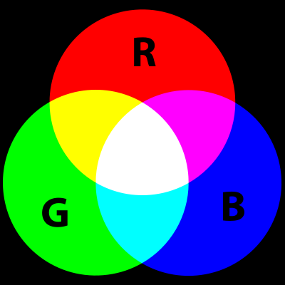
RGB Additive Color
Red, Green, Blue
Color model used in luminous displays (CRT, plasma, LCD)
Physically linear
Perceptually logarithmic
Additive
Designed to stimulate each kind of cone

Slide 5
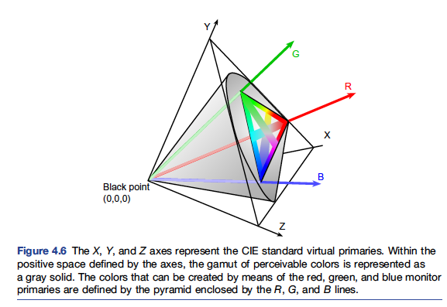
CIE Color Space
From Information Visualization by Colin Ware

Slide 6
Color
The finite set of colors a monitor can show is the gamut
Tone Mapping
Uses a finite set of colors to approximate a scene with a wider range
In theory, our simulation of light could produce values for (r,g,b) in which the components take on any positive value
The color components (channels) must be mapped to [0,1] and then to [0,255] typically
Gamma correction
monitor brightness given by voltage v and gamma = 1.8 or 2.2
(255,255,255) will appear more than twice as bright as (125,125,125)
gamma correction linearizes brightness by raising each component to an inverse power of gamma

Slide 7
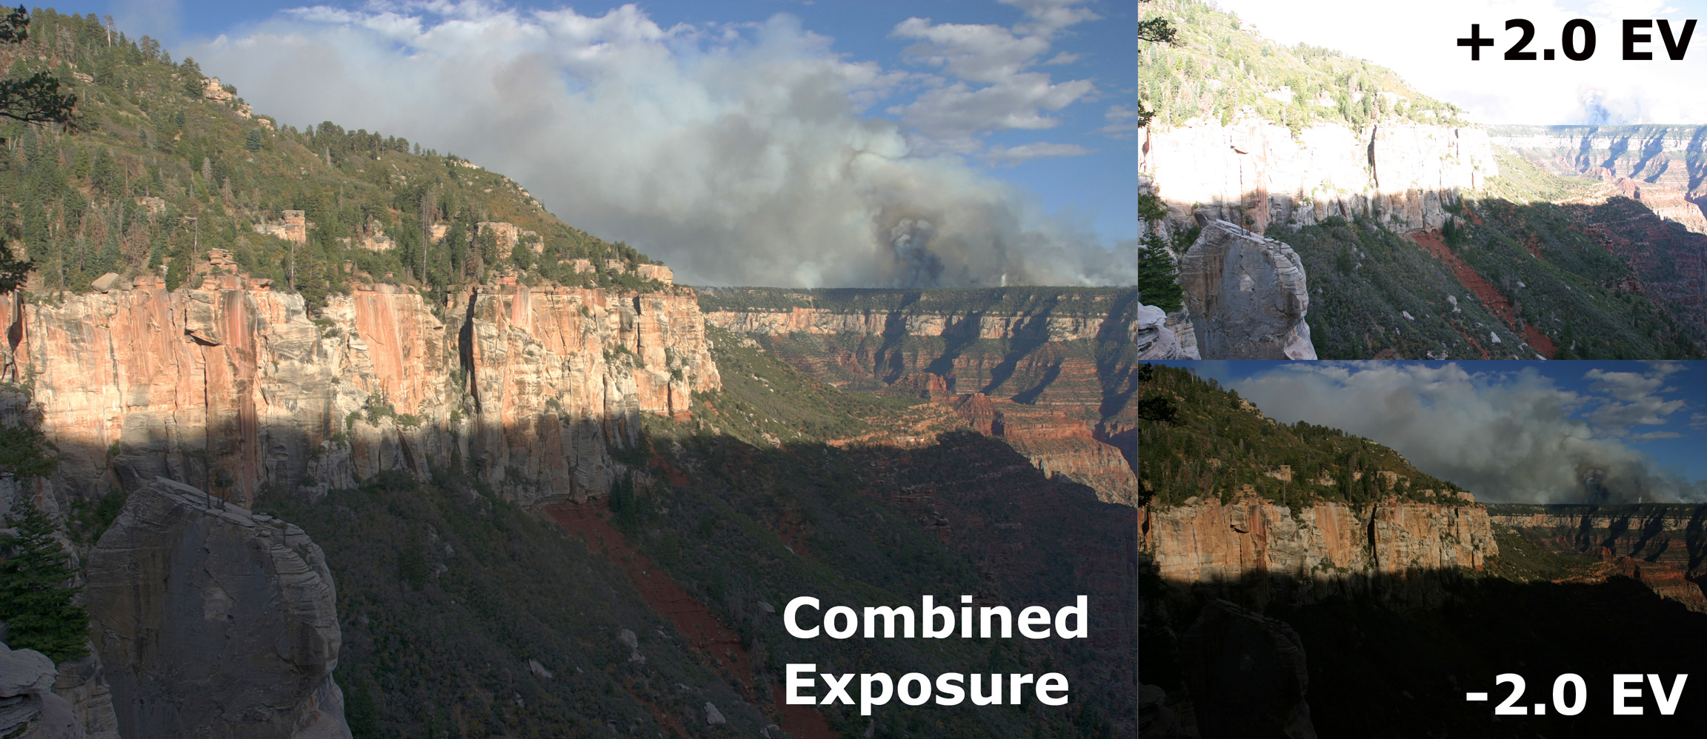
Tone Mapping
“…map one set of colors to another to approximate the appearance of high dynamic range images in a medium that has a more limited dynamic range.” -- Wikipedia

Slide 8
Aliasing
Aliasing is an effect caused by discrete sampling
With digital images
We have a finite number of pixels
We have a finite number of colors
…which will not always be able to render a scene accurately
Some common aliasing phenomena are
jaggies
moire patterns
loss of small details in textures

Slide 9
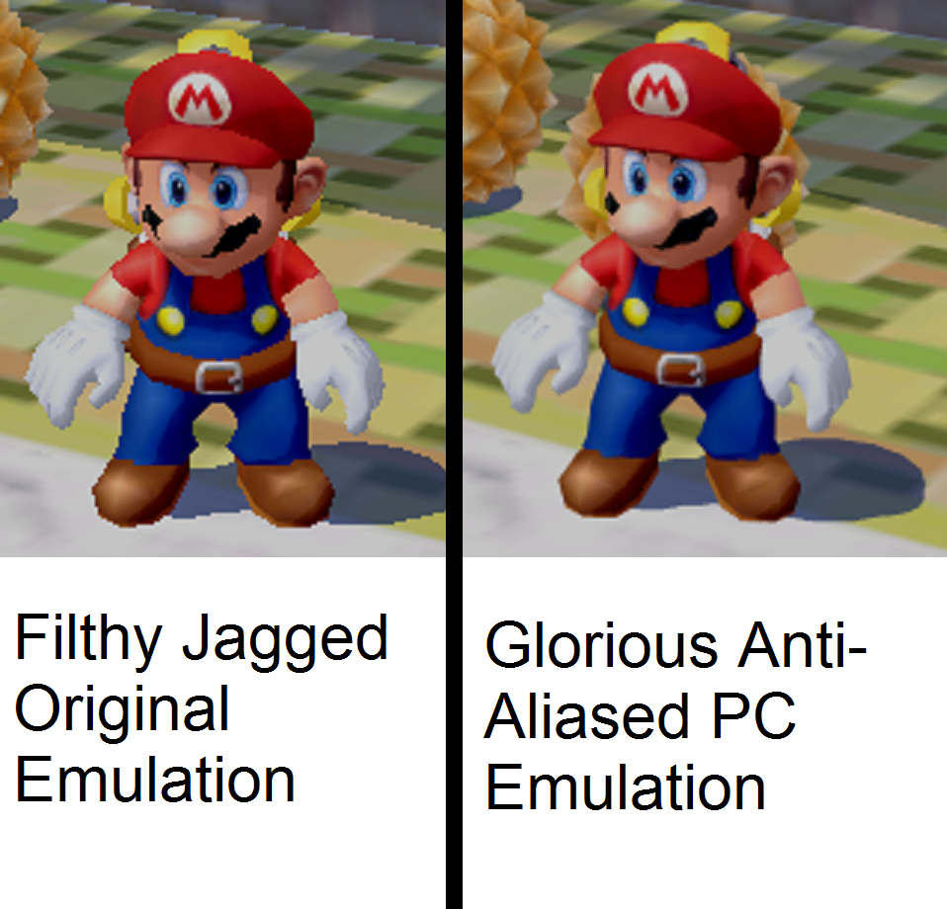
Mario…

Slide 10
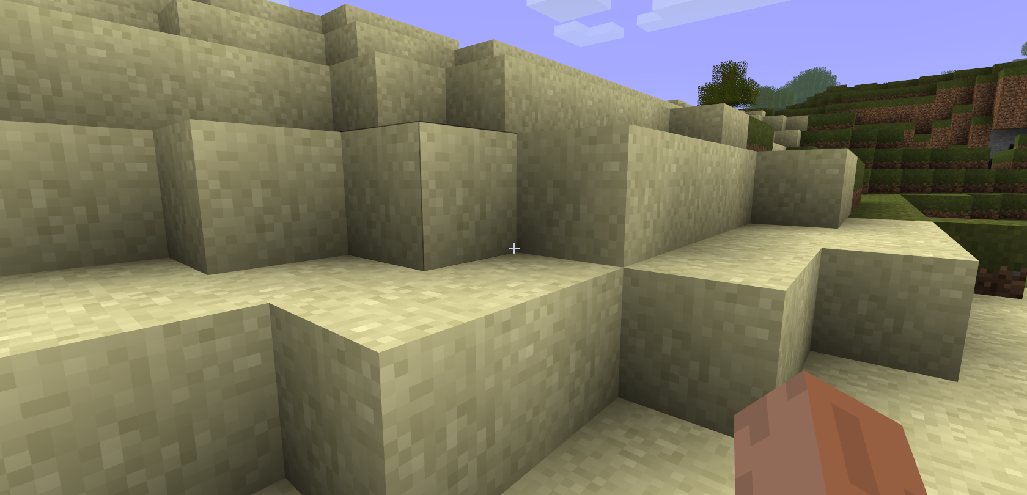
Minecraft with anti-aliasing…
…maybe not as easy to see in a world made of blocks

Slide 11
Aliasing in Ray Tracing
Imagine a yellow polygon in a scene.
We have a 5x7 array of pixels and shoot rays through the pixel centers
We get a jagged edge….
How could we generate a better approximation?
Notes:
Shooting through the center of the pixels…in pixels that should be bi-colored we get mono-color. Jaggies.
What are some obvious steps to take: More pixels….
Alternatively…more colors…we could make the pixel an area-weighted average of the 2 colors in it…

Slide 12
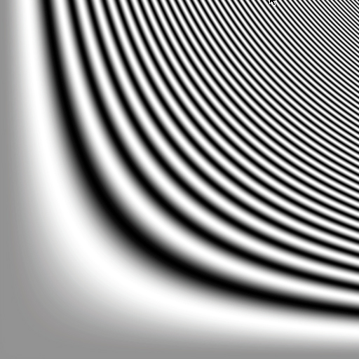
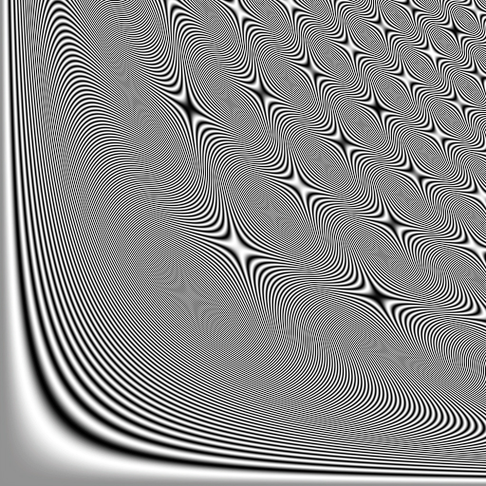
Moire patterns
Second images show what happens when we try to squeeze a bigger domain into the same 512x512 pixels
As an aside….how do you ray cast f(x,y) ?
Notes:
First picture is x,y in [0,3.79] and bands are all more than two pixels wide
Second is [0, 10.83] and we get moire patterns in which we “see” two superimposed signals
mwar

Slide 13
Anti-aliasing
One remedy to aliasing is to shoot more rays per-pixel
Sampling pattern Pixel on the edge Final color on a single pixel
REGULAR SAMPLING
We use an n by n regular sub-grid and shoot through the sub-pixels
Color is the average color returned by the sub-samples
Image shows one pixel with 25 sub-samples

Slide 14
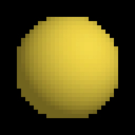
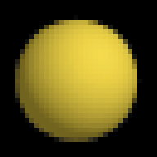
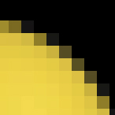
A Ray Tracing Example
One ray per pixel 16 rays per pixel Enlarged view

Slide 15
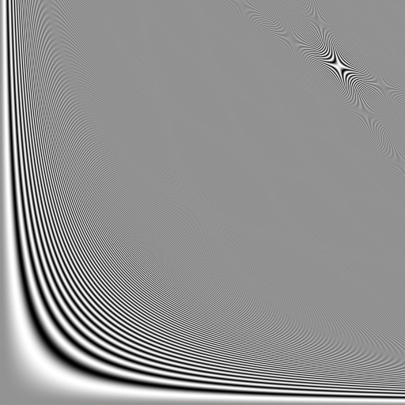
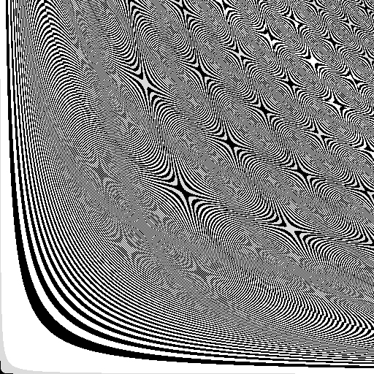
Problems with Regular Sampling
Still often leads to “regular” artifacts
Humans are great at perceiving induced regular patterns
Notes:
Moire patterns persist even with 5x5 subsampling….second image enhances contrast and the moire patterns pop….

Slide 16
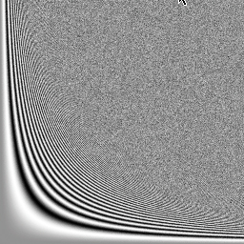
Random Sampling
Could use N random locations in the pixel
Often makes things look noisy, but…
…people prefer noise to aliasing visually
Notes:
What is the obvious problem…can have clumping

Slide 17
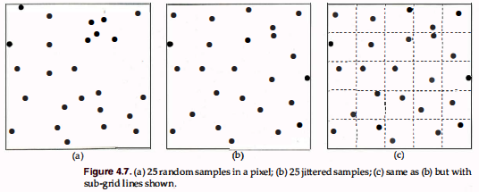
Jittered Sampling
Use a regular grid of n by n subpixels
Use random location within each subpixel

Slide 18
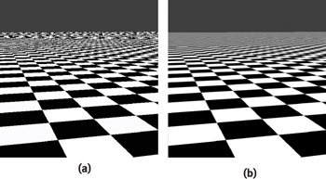
Fine Detail
Pixels on the horizon cover an infinite area
Projected size of a square becomes infinitely small at horizon
We cannot sample enough to preserve infinite detail

Slide 19
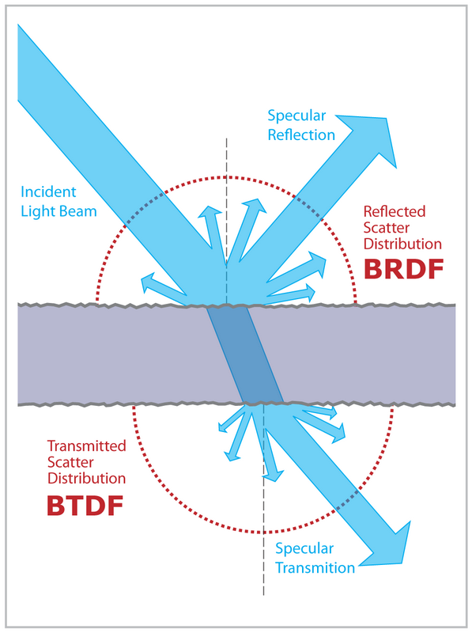
Some Quick Definitions
BRDF: Bidirectional reflectance distribution function
4D function modeling light reflected at an opaque surface.
BTDF: Bidirectional transmittance distribution function
used for subsurface scattering among other things

Slide 20
Sampling
We need to sample and reconstruct lots of things
For depth of field you need to model and sample a finite area lens
Area lights and soft shadows require sampling the light surfaces
For glossy reflection and transmission you need to sample BRDFs & BTRFs

Slide 21
2D Sampling
Assume we are sampling a function on a unit square
Good sampling
Uniform(ish) distribution…avoid gaps and clumps
Projections into 1D along x and y are also uniform(ish)
There is a non-trivial minimum distance between all sample points
Such a sample pattern is called Well-Distributed
Ultimately we want a sampling pattern that
Generates a quality result with a minimum number of samples
…i.e. approximation converges more quickly…less rendering time

Slide 22
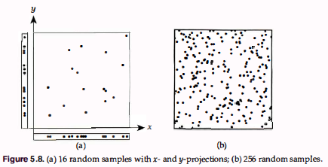
Random
Fails

Slide 23
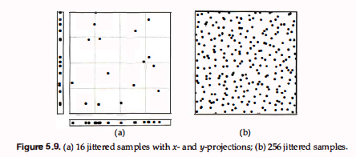
Jittered
Example of stratified sampling
Significantly better than random

Slide 24
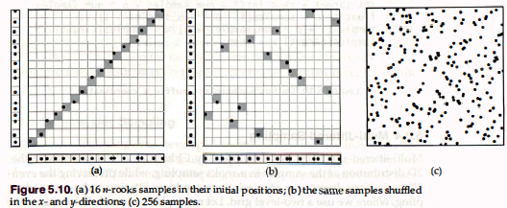
n-Rooks
Also called Latin hypercube sampling
Use and n by n grid
One sample exactly in each row and column
i.e. if samples were rooks in chess, no captures can occur

Slide 25
n-Rooks
Produced by random shuffle of diagonal samples
Must maintain the rook condition
Use n samples instead of n² as in jittered
1D distributions are good
2D not better than random…worse than jittered

Slide 26
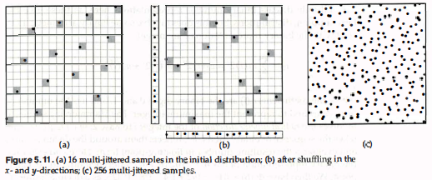
Multi-Jittered Sampling
We use two grids
Coarse grid with 1 sample per cell
Fine grid on which we enforce the rook condition

Slide 27
Multi-Jittered Sampling
Good 1D projections from the rook condition
Good 2D distribution from stratification
For n samples with n a perfect square
Coarse grid is √n ✕ √n
Fine grid is n ✕ n
Very good sampling technique

Slide 28
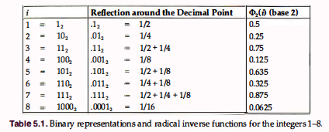
Hammersley Sampling
Radical inverse function of integer i to base 2
reflect binary digits of i across decimal point
evaluate this new number now in [0,1)

Slide 29
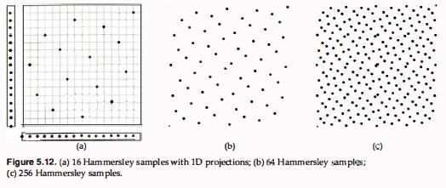
Hammersley Sequence
Set of n 2D samples in unit square:
Book Formula on page 108 is wrong

Slide 30
Hammersley Issues
Pattern is well-sampled but…
1D projections are regular
Too much structure in the pattern
For a given n only one sequence exists (read section 5.1)

Slide 31
Halton Sequence
Better low discrepancy sequence
Generate n-dimensional points
though Hammersley can be generalized as well….
Number of samples need not be known in advance

Slide 32
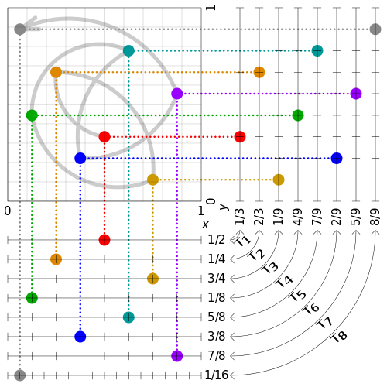
Halton Sequence Example
The 2,3 Halton Sequence

Slide 33
Discrepancy
Imagine points in some space S = [0,1]^{n}
Suppose we sample using K points…
We can evaluate the quality by
take portion V of S
volume V/volume S should equal (number points in V)/K
…but it generally won’t
the difference is the discrepancy
Different formal ways to measure discrepancy…see PBR

Slide 34
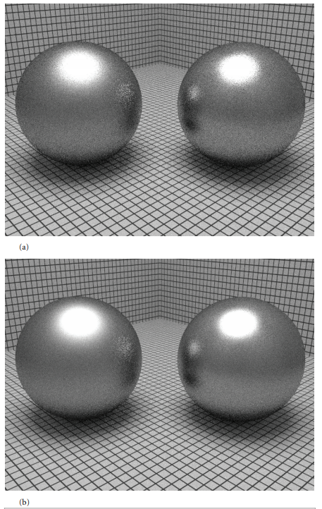
Better Sampling
Same number of samples in both images...
…only the distribution of samples differs

Slide 35
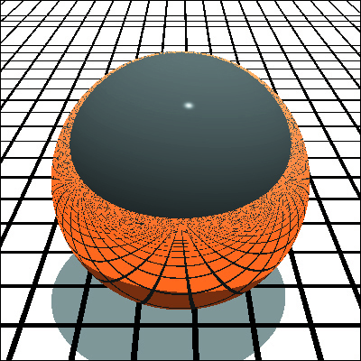
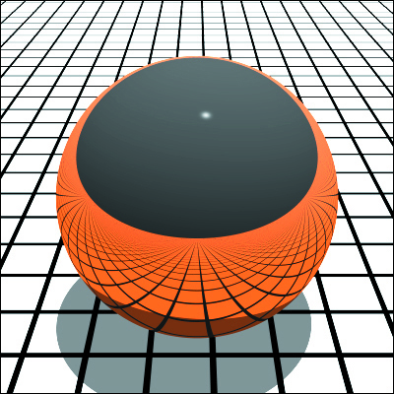
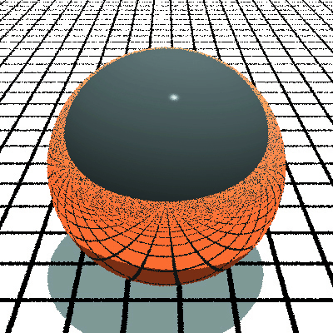
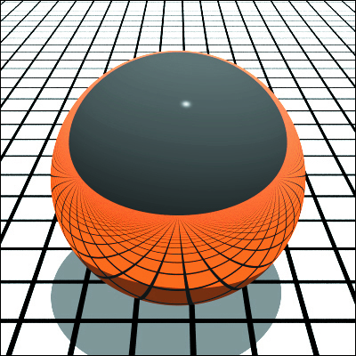
Some Results
Regular, 1 and 256 samples per pixel
Random, 1 and 256 samples per pixel

Slide 36


Some Results
Jittered
N-Rooks

Slide 37
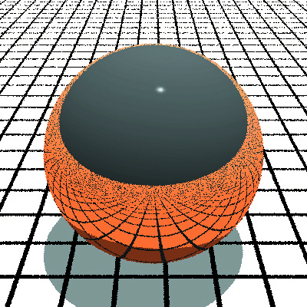
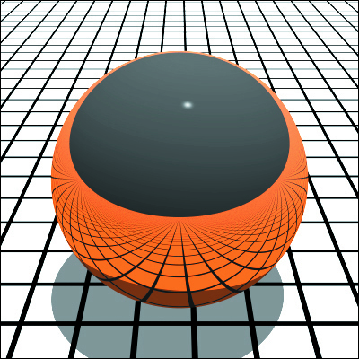
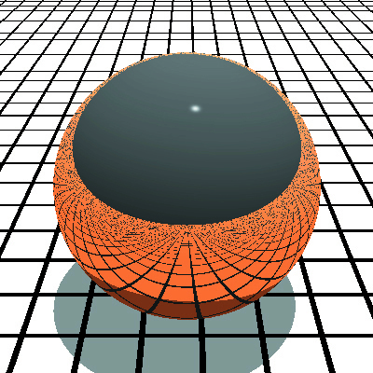
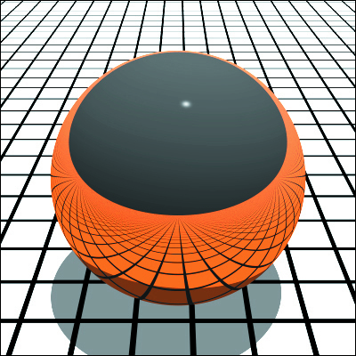
Some Results
Multi-jittered
Hammersley

Slide 38
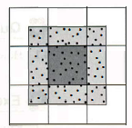
Filtering
In ray-tracing this means using rays outside pixel boundary as well as inside to generate the color
The weight scheme of the samples determines the type of filter
Box: All rays equally weighted
Tent: Sample importance decreases linearly away from center
Cubic: Importance decrease as cubic polynomial
Gaussian: Importance decreases exponentially
What benefit do you get from filtering?

Slide 39
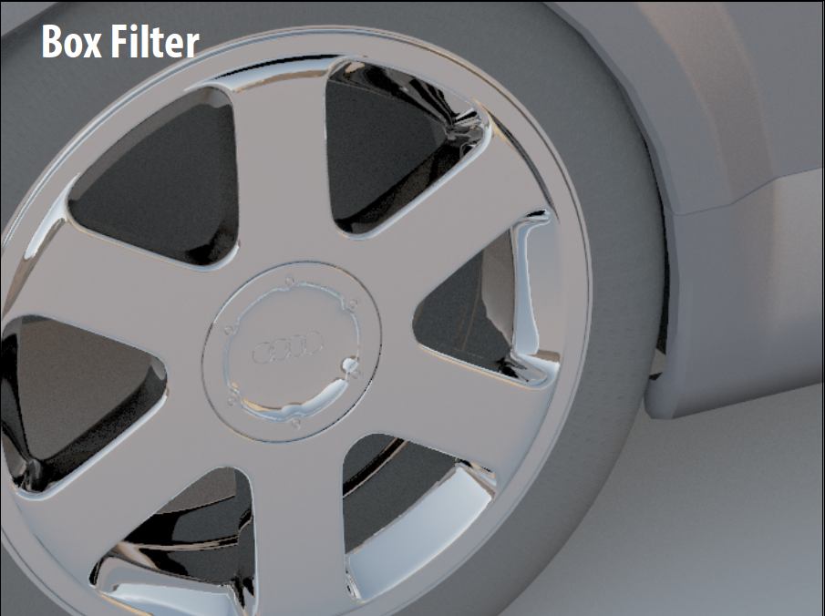
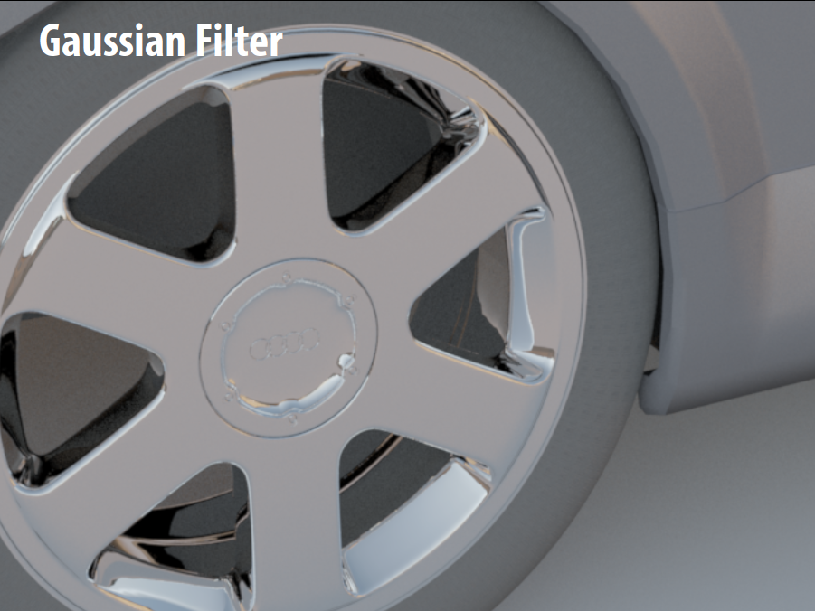
Filters: Examples

Slide 40
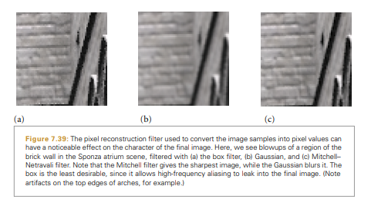
Filters: Examples
From Physically-Based Rendering by Pharr, et al

